Slide 1
Argus Iron Ore: The ICX62 Index

Slide 2
Argus Media group notices
The Argus Media group (referred to herein as “Argus”) makes no representations or warranties or other assurance, express or implied, about the accuracy or suitability of any information in this presentation and related materials (such as handouts, other presentation documents and recordings and any other materials or information distributed at or in connection with this presentation).
The information or opinions contained in this presentation are provided on an “as is” basis without any warranty, condition or other representation as to its accuracy, completeness, or suitability for any particular purpose and shall not confer rights or remedies upon the recipients of this presentation or any other person. Data and information contained in the presentation come from a variety of sources, some of which are third parties outside Argus’ control and some of which may not have been verified.
All analysis and opinions, data, projections and forecasts provided may be based on assumptions that are not correct or which change, being dependent upon fundamentals and other factors and events subject to change and uncertainty; future results or values could be materially different from any forecast or estimates described in the presentation.
To the maximum extent permitted by law, Argus expressly disclaims any and all liability for any direct, indirect or consequential loss or damage, claims, costs and expenses, whether arising in negligence or otherwise, in connection with access to, use or application of these materials or suffered by any person as a result of relying on any information included in, or omission from, this presentation and related materials or otherwise in connection therewith.
The information contained in this presentation and related materials is provided for general information purposes only and should not be construed as legal, tax, accounting or investment advice or the rendering of legal, consulting, or other professional services of any kind. Users of these materials should not in any manner rely upon or construe the information or resource materials in these materials as legal, or other professional advice and should not act or fail to act based upon the information in these materials.
Copyright © 2018 Argus Media group. All rights reserved.

Slide 3
Agenda
Company Introduction
Methodology
Transparency
Copyright © 2018 Argus Media group. All rights reserved.

Slide 4
Company introduction

Slide 5
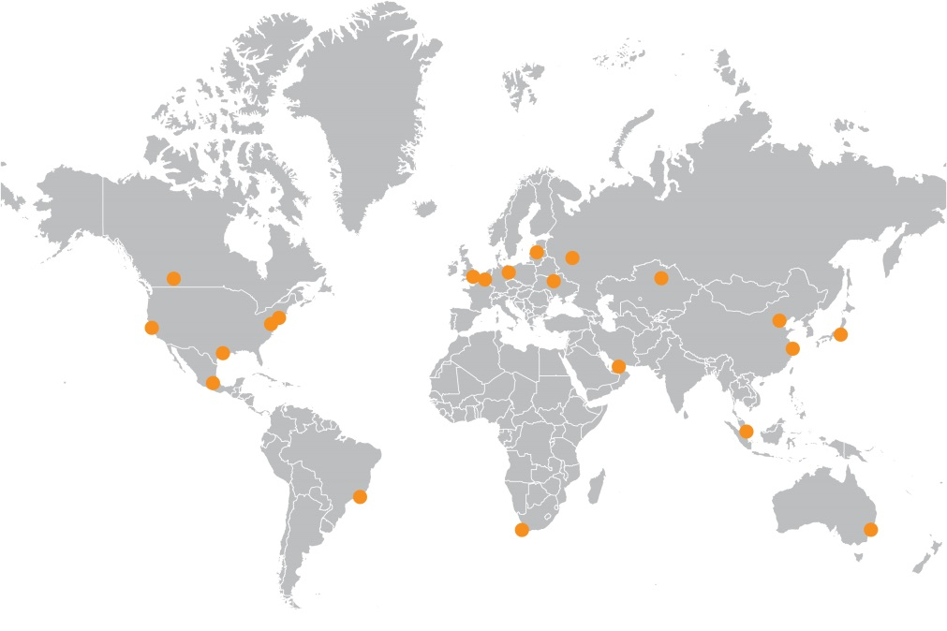




Global, Market-focused, Independent
The Argus The world’s leading PRA, with a team of 850 from 21 global offices
11,000 plus daily price assessments
IOSCO compliant methodology
Also offers…
Market intelligence for world commodities markets
Bespoke consulting services and training.
Conferences and forums
Coverage includes:
Energy
Fertilizers
Petrochemicals
Global metals
Copyright © 2018 Argus Media group. All rights reserved.

Slide 6
Methodology

Slide 7
Argus ICX62pc index: Evolved and ready for use
Extensive evolutions since September 2017 are aimed at establishing a market-leading alternative:
  The most experienced team of any PRA at managing iron ore benchmarks – both financial and physical.
  Bespoke iron ore methodology tailored to needs of 2018 and beyond
  Volume-weighted average methodology combined with IOSCO data hierarchy
  Integration of index-linked pricing and futures markets
  Expansion of port stock coverage
  Daily lump pricing
  Intra-day pricing initiated
 | ICX
International Price Reporting Agency with size and scale
Organisation-Wide Compliance Framework | ✓
Stable Team: average of 5 years of ore experience | ✓
Benchmark Administration Experience (Paper/Phys) | ✓
Methodology Tailored to the Iron Ore Sector | ✓
All Day Volume-Weighted Average, maximising data | ✓
Seaborne and Portside iron ore indices | ✓
Daily published rationale | ✓
Input transparency | ✓
Monthly Audit | ✓
Systemic incorporation of floating price trades | ✓
Time normalisation of trades to the same point in time | ✓
Forward Curve Integration | ✓
Open Sourcing of data: trade data prioritised, not venue | ✓
Increasing frequency of trade data availability | ✓
Intraday pricing started: seaborne, portside and indicators | ✓
Copyright © 2018 Argus Media group. All rights reserved.

Slide 8
The Argus ICX™62pc Iron Ore Index: Principles
Collection of the broadest possible set of verifiable data.
Processing this data in a consistent, explicable process to produce the final price.
Minimizing of subjectivity through quantitative approach to index calculation.
Spot transactions
reported by market
Screened for outliers
Volume-weighted average Index
Normalised to ICX
Copyright © 2018 Argus Media group. All rights reserved.

Slide 9

Methodology in brief: how is data weighted?
Under a volume-weighted average system, an increased pool of market data is accorded different volume weightings (in brackets).
Data is sorted into four tiers. Fixed price transactions with a full audit trail receive full weighting; floating price transactions are next; then screen bids/offers.
As a fall-back (<7 data points in top three tiers), bilateral bids and offers may be used at a low weight (5%).
Outliers are statistically determined and automatically removed from the average
E-Platform trades
Bilateral trades (100%)
Floating trades
bids/offers (50%)
Platform Bid/Offer (20%)
Fall-back
Trade data
(bids and offers)
and indicative levels (5%)
Copyright © 2018 Argus Media group. All rights reserved.

Slide 10
Methodology in brief: how is data normalized?
Each data point is normalized for quality to the Argus ICX™62pc index specification using published adjustments.
Each data point is normalized for timing to the middle of a 2-6 week delivery window.
This is done using the financial forward curve to derive a daily adjustment.
The financial forward curve is used as it is for a standardized contract with price differences due purely to timing.
Value-in-Market (ViM) quality adjustments (9 Feb) $/t
Adjustment | Change | Range |  | ±
Iron | Per 1% Fe | 60%-63% | 1.20 | 0.5
 |  | <4.5% | 0.20 | -0.15
Silica | Per 1% SiO2 | 4.5%-6% | 2.00 | 0.10
 |  | >6% | 3.00 | nc
Alumina | Per 1% Al2O3 | 1-3% | 1.00 | 0.50
 |  | <0.08% | 0.00 | -0.15
Phosphorus | Per 0.01% P | 0.08-0.1% | 0 | nc
 |  | >0.1% | 2 | 0.25
Daily backwardation = (M2-M1)/days in month
Copyright © 2018 Argus Media group. All rights reserved.

Slide 11
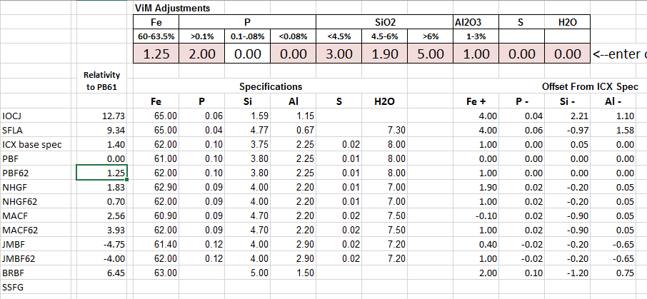
Methodology in brief: How are ViM determined?
At the end of each week Argus conducts:
  An analysis of received transaction data
  A market survey of brand relativities
The impact of each variable (Fe, SiO2, Al2O3 and P) on price are analyzed in isolation.
These are adjusted to create line of best fit (LOBF) between ViM and relativities between mainstream medium brands (based on typical spec).
IM variables are then ‘sanity checked’ by:
  Comparing VIM-derived iron ore brand relativities vs result of Market Survey of brand relativities
  Comparing results of Market Discussions of VIM values vs LOBF-data derived VIM values.
Copyright © 2018 Argus Media group. All rights reserved.

Slide 12
Methodology in brief: Floating price normalization
Floating price transactions are normalized against the iron ore futures forward curve.
This is only done for the 62pc index (where there is a liquid curve).
Where the floating price structure is 62pc Index Month Average + premium, the forward price for the index month serves as a proxy.
E.g. PB Fines trades at April P62 +1.7. The April swap is at $77.3. Fixed price assumed at $79/dmt.
Value-in-Market (ViM) quality adjustments (9 Feb) $/t
Adjustment | Change | Range |  | ±
Iron | Per 1% Fe | 60%-63% | 1.20 | 0.5
 |  | <4.5% | 0.20 | -0.15
Silica | Per 1% SiO2 | 4.5%-6% | 2.00 | 0.10
 |  | >6% | 3.00 | nc
Alumina | Per 1% Al2O3 | 1-3% | 1.00 | 0.50
 |  | <0.08% | 0.00 | -0.15
Phosphorus | Per 0.01% P | 0.08-0.1% | 0 | nc
 |  | >0.1% | 2 | 0.25
Copyright © 2018 Argus Media group. All rights reserved.

Slide 13
Methodology in brief: Why use floating price prices?
Post normalization correlation between fixed and floating price strong.
Floating data transaction depth now significant and growing.
Floating price transactions accorded 50% volume weight to give fixed prices priority.
Copyright © 2018 Argus Media group. All rights reserved.

Slide 14
Lump premium
The lump premium (LP) follows the same weighting structure. But there is no inclusion of floating price deals (against a LP index)
The LP is calculated as a volume weighted average of LPs.
Currently there are only adjustments for FOB-CFR.
There is no brand, VIM or timing adjustment. It is based on PBL.
E-Platform trades
Bilateral trades (100%)
Platform Bid/Offer (20%)
Fall-back
Trade data
(bids and offers)
and indicative levels (5%)
Copyright © 2018 Argus Media group. All rights reserved.

Slide 15
Transparency

Slide 16
A highly transparent index
The Argus ICX aims to capture the widest set of data while sharing as much as possible about the index inputs:
  Transparency of process: the price calculation process is applied consistently.
  Transparency of workings: Daily rationales are now published in Argus Ferrous Markets (AFM). A daily data breakdown will be published daily at around 7pm (see example, right).
  Transparency of inputs: Monthly Data Audits show what went into the ICX™62pc index each month (next slide).
  Transparency of data: A daily deals table lists out trades which are widely known to the market/publicly transacted on platform (next, next slide).
ICX™ index rationale data points (daily) (12 Jun)
For 12 Jun ICX™: | 64.35
Tier 1: Fixed-price deals (100%)
Number of data points | 2
Avg. normalised price | 64.33
Statistical exclusions | 0
Weighted Avg. post-exclusions | 64.33
ICX™ total weight | 82%
Tier 2: Floating-price deals (50%)
Number of data points | 0
Avg. normalised price | n/a
Statistical exclusions | 0
Weighted Avg. post-exclusions | n/a
ICX™ total weight | 0%
Tier 3: Executable platform bid/ask (20%)
Number of data points | 2
Avg. normalised price | 64.09
Statistical exclusions | 1
Weighted Avg. post-exclusions | 64.57
ICX™ total weight | 1
Tier 4: Bilateral bid/ask/indicative (5%)
Number of data points | 7
Avg. normalised price | 64.26
Statistical exclusions | 2
Weighted Avg. post-exclusions | 64.12
ICX™ total weight | 10%
Other data
Upper statistical exclusion limit | 64.57
Lower statistical exclusion limit | 63.92
M1/M2 backwardation
Daily timing adjustment
Copyright © 2018 Argus Media group. All rights reserved.

Slide 17
Monthly data audit supports cross industry trust
Copyright © 2018 Argus Media group. All rights reserved.

Slide 18
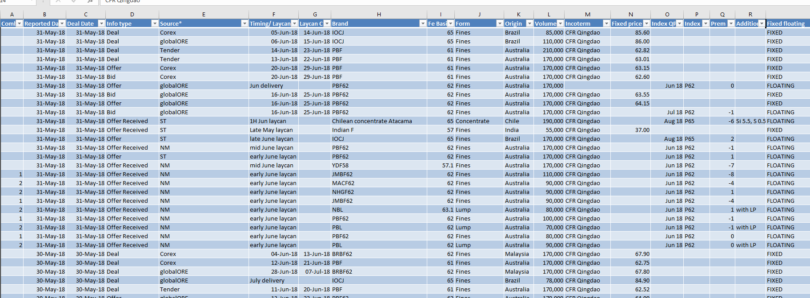
Deals, bids & offers table
Monthly, downloadable spreadsheets with bid/offer/deal data
Excel file revamped with granular, easy to filter data, number and date formatted for ease.
Frequency will increase to weekly
Looking to add port stock data
Copyright © 2018 Argus Media group. All rights reserved.

Slide 19
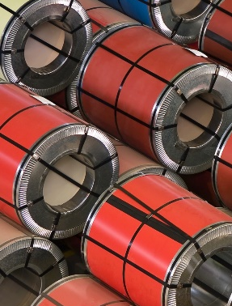


Three Global Metals Products
Argus Metal Prices
International Scrap focus:
Ferrous & Non-Ferrous
Argus Ferrous Markets
Steel making raw materials, focus on iron ore & coking coal
Argus Metals International
Minor Metals, Rare Earths, Ferro-Alloys
Each product has a daily pdf and access to the powerful online Argus Metals Platform
Contact us at metals@argusmedia.com for more information!
For the United States, the support number to dial is (713) 360-7568
For international inquiries outside the United States, +44 (0) 2079526778
Copyright © 2018 Argus Media group. All rights reserved.

Slide 20


Contact the Argus Iron Ore Team:
Beijing (+86)
Xin Xin Hao:
Linca Sun:
Carrie Shi:
108 535 6889
108 535 7662
108 535 7603
Shanghai (+86)
Julie Jiang:
Yan Yukan:
Oscar Tarneberg:
108 535 7618
108 535 7619
108 535 7620
Singapore (+65)
Chris Newman:
Prasenjit Bhattacharya:
Kitty Liqin:
Tim Hard:
6496 9959
6496 9954
6496 9995
6496 9894
Stay Connected
@ArgusMedia Argus-media
+Argusmediaplus argusmediavideo
Copyright notice
Copyright © 2018 Argus Media group. All rights reserved. All intellectual property rights in this presentation and the information herein are the exclusive property of Argus and and/or its licensors and may only be used under licence from Argus. Without limiting the foregoing, you will not copy or reproduce any part of its contents (including, but not limited to, single prices or any other individual items of data) in any form or for any purpose whatsoever without the prior written consent of Argus.
Trademark notice
ARGUS, the ARGUS logo, Argus publication titles, and Argus index names are trademarks of Argus Media Limited. For additional information, including details of our other trademarks, visit argusmedia.com/trademarks.

